Slide 1

Carbon and the Molecular Diversity of Life

Slide 2

Overview: Carbon: The Backbone of Life
Although cells are 70–95% water, the rest consists mostly of carbon-based compounds
Carbon is unparalleled in its ability to form large, complex, and diverse molecules
Proteins, DNA, carbohydrates, and other molecules that distinguish living matter are all composed of carbon compounds
Copyright © 2008 Pearson Education, Inc., publishing as Pearson Benjamin Cummings

Slide 3
Concept 4.1: Organic chemistry is the study of carbon compounds
Organic chemistry is the study of compounds that contain carbon
Organic compounds range from simple molecules to colossal ones
Most organic compounds contain hydrogen atoms in addition to carbon atoms
Copyright © 2008 Pearson Education, Inc., publishing as Pearson Benjamin Cummings

Slide 4
Vitalism, the idea that organic compounds arise only in organisms, was disproved when chemists synthesized these compounds
Mechanism is the view that all natural phenomena are governed by physical and chemical laws
Copyright © 2008 Pearson Education, Inc., publishing as Pearson Benjamin Cummings

Slide 5

Concept 4.2: Carbon atoms can form diverse molecules by bonding to four other atoms
Electron configuration is the key to an atom’s characteristics
Electron configuration determines the kinds and number of bonds an atom will form with other atoms
Copyright © 2008 Pearson Education, Inc., publishing as Pearson Benjamin Cummings

Slide 6

The Formation of Bonds with Carbon
With four valence electrons, carbon can form four covalent bonds with a variety of atoms
This tetravalence makes large, complex molecules possible
In molecules with multiple carbons, each carbon bonded to four other atoms has a tetrahedral shape
However, when two carbon atoms are joined by a double bond, the molecule has a flat shape
Copyright © 2008 Pearson Education, Inc., publishing as Pearson Benjamin Cummings

Slide 7
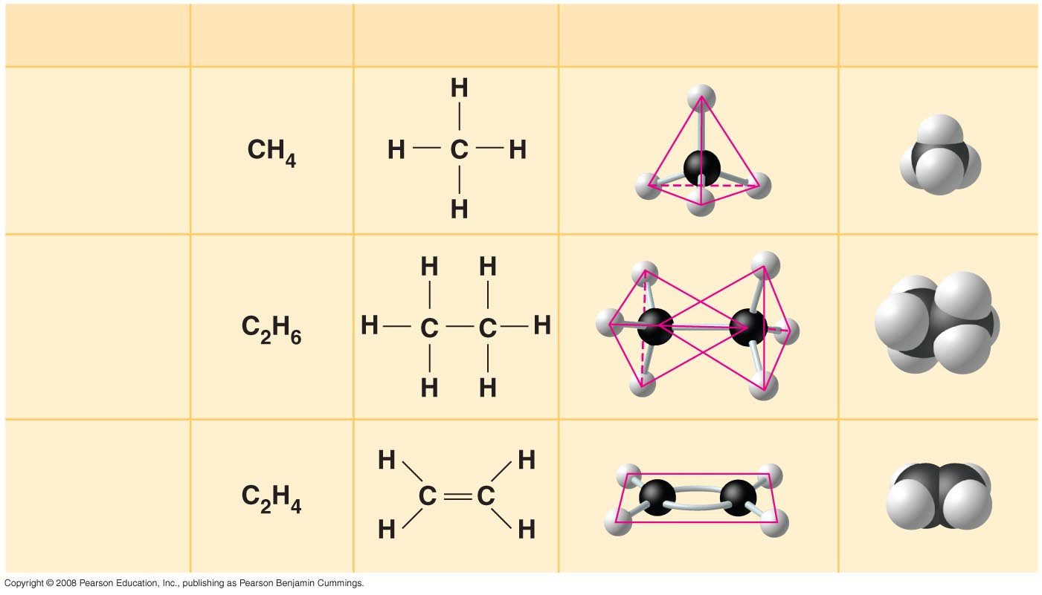

Fig. 4-3
Molecular Formula
Structural Formula
Ball-and-Stick
Model
Space-Filling
Model
Name
(a) Methane
(b) Ethane
(c) Ethene
(ethylene)
Notes:
Figure 4.3 The shapes of three simple organic molecules

Slide 8

The electron configuration of carbon gives it covalent compatibility with many different elements
The valences of carbon and its most frequent partners (hydrogen, oxygen, and nitrogen) are the “building code” that governs the architecture of living molecules
Copyright © 2008 Pearson Education, Inc., publishing as Pearson Benjamin Cummings

Slide 9
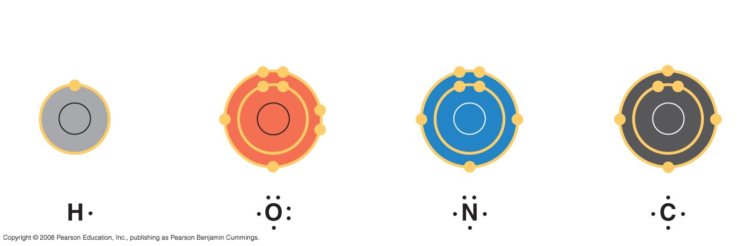
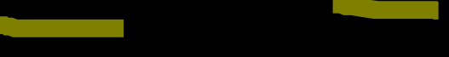
Fig. 4-4
Hydrogen
(valence = 1)
Oxygen
(valence = 2)
Nitrogen
(valence = 3)
Carbon
(valence = 4)
H
O
N
C
Notes:
Figure 4.4 Valences of the major elements of organic molecules

Slide 10

Carbon atoms can partner with atoms other than hydrogen; for example:
Carbon dioxide: CO₂
Urea: CO(NH₂)₂
O = C = O
Copyright © 2008 Pearson Education, Inc., publishing as Pearson Benjamin Cummings

Slide 11

Molecular Diversity Arising from Carbon Skeleton Variation
Carbon chains form the skeletons of most organic molecules
Carbon chains vary in length and shape
Copyright © 2008 Pearson Education, Inc., publishing as Pearson Benjamin Cummings

Slide 12

Hydrocarbons
Hydrocarbons are organic molecules consisting of only carbon and hydrogen
Many organic molecules, such as fats, have hydrocarbon components
Hydrocarbons can undergo reactions that release a large amount of energy
Copyright © 2008 Pearson Education, Inc., publishing as Pearson Benjamin Cummings

Slide 13
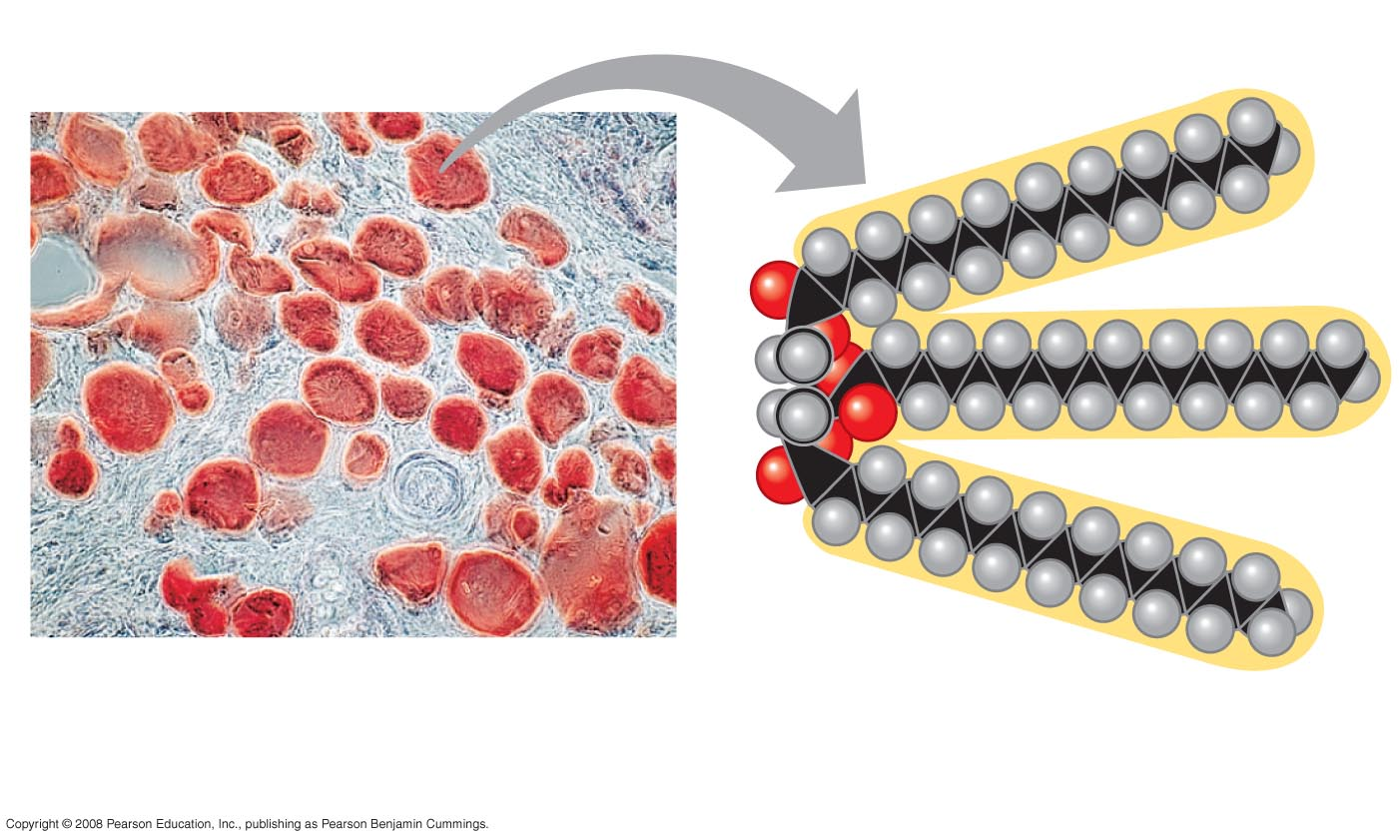

Fig. 4-6
Fat droplets (stained red)
100 µm
(a) Mammalian adipose cells
(b) A fat molecule
Notes:
Figure 4.6 The role of hydrocarbons in fats

Slide 14

Isomers
Isomers are compounds with the same molecular formula but different structures and properties:
Structural isomers have different covalent arrangements of their atoms
Geometric isomers have the same covalent arrangements but differ in spatial arrangements
Enantiomers are isomers that are mirror images of each other
Copyright © 2008 Pearson Education, Inc., publishing as Pearson Benjamin Cummings

Slide 15
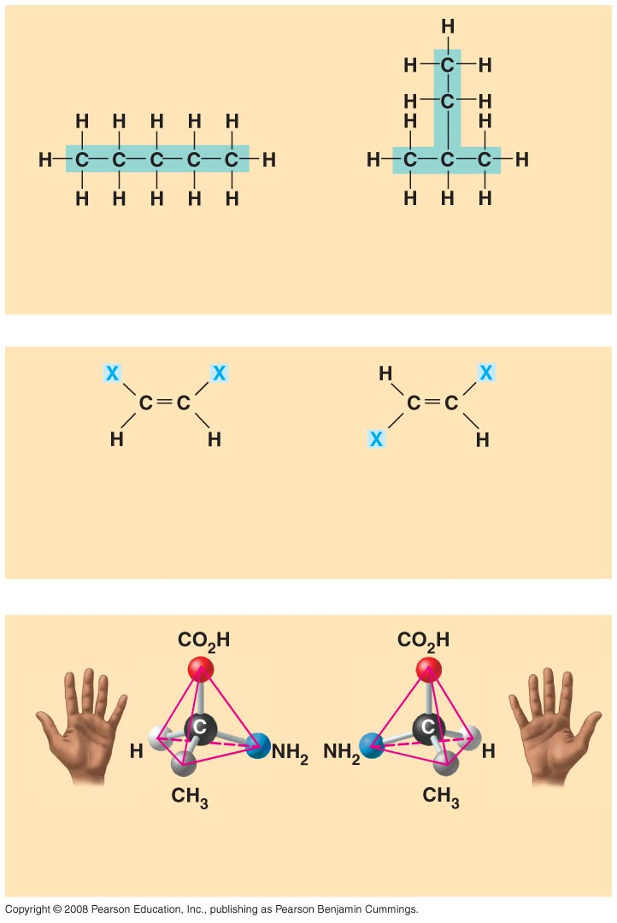

Fig. 4-7
Pentane
2-methyl butane
(a) Structural isomers
cis isomer: The two Xs are
on the same side.
trans isomer: The two Xs are
on opposite sides.
(b) Geometric isomers
L isomer
D isomer
(c) Enantiomers
Notes:
Figure 4.7 Three types of isomers

Slide 16

Enantiomers are important in the pharmaceutical industry
Two enantiomers of a drug may have different effects
Differing effects of enantiomers demonstrate that organisms are sensitive to even subtle variations in molecules
Copyright © 2008 Pearson Education, Inc., publishing as Pearson Benjamin Cummings

Slide 17
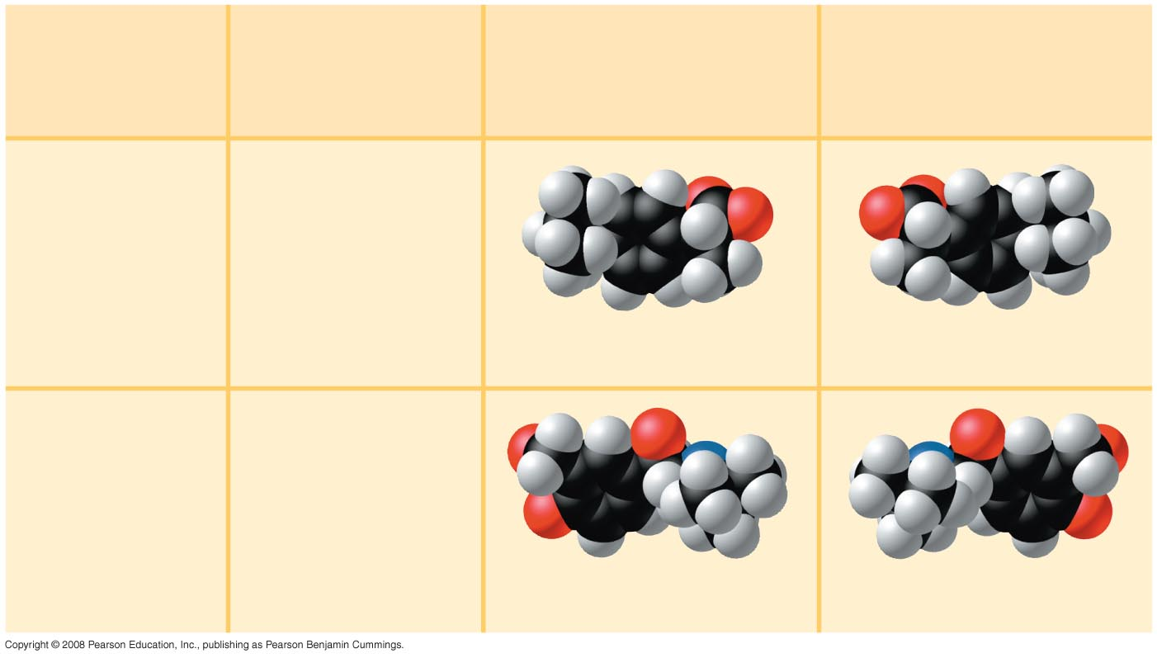

Fig. 4-8
Effective
Enantiomer
Ineffective
Enantiomer
Drug
Condition
Ibuprofen
Pain;
inflammation
S-Ibuprofen
R-Ibuprofen
Albuterol
Asthma
R-Albuterol
S-Albuterol
Notes:
Figure 4.8 The pharmacological importance of enantiomers

Slide 18

Concept 4.3: A small number of chemical groups are key to the functioning of biological molecules
Distinctive properties of organic molecules depend not only on the carbon skeleton but also on the molecular components attached to it
A number of characteristic groups are often attached to skeletons of organic molecules
Copyright © 2008 Pearson Education, Inc., publishing as Pearson Benjamin Cummings

Slide 19

The Chemical Groups Most Important in the Processes of Life
Functional groups are the components of organic molecules that are most commonly involved in chemical reactions
The number and arrangement of functional groups give each molecule its unique properties
Copyright © 2008 Pearson Education, Inc., publishing as Pearson Benjamin Cummings

Slide 20
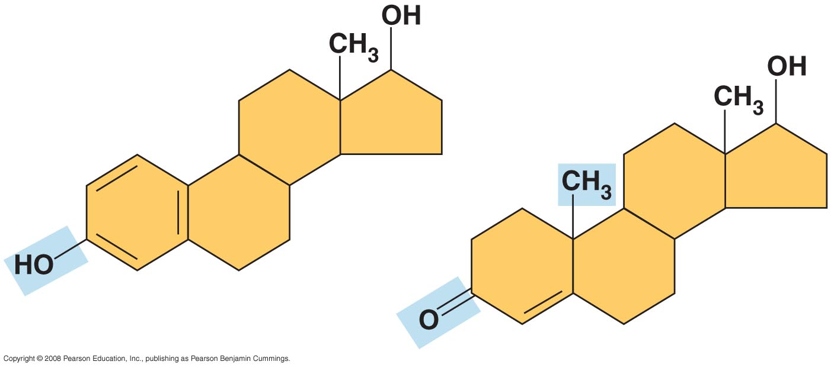
Fig. 4-9
Estradiol
Testosterone
Notes:
Figure 4.9 A comparison of chemical groups of female (estradiol) and male (testosterone) sex hormones

Slide 21

The seven functional groups that are most important in the chemistry of life:
Hydroxyl group
Carbonyl group
Carboxyl group
Amino group
Sulfhydryl group
Phosphate group
Methyl group
Copyright © 2008 Pearson Education, Inc., publishing as Pearson Benjamin Cummings

Slide 22

ATP: An Important Source of Energy for Cellular Processes
One phosphate molecule, adenosine triphosphate (ATP), is the primary energy-transferring molecule in the cell
ATP consists of an organic molecule called adenosine attached to a string of three phosphate groups
Copyright © 2008 Pearson Education, Inc., publishing as Pearson Benjamin Cummings

Slide 23
The Chemical Elements of Life: A Review
The versatility of carbon makes possible the great diversity of organic molecules
Variation at the molecular level lies at the foundation of all biological diversity
Copyright © 2008 Pearson Education, Inc., publishing as Pearson Benjamin Cummings

